Slide 1
FrontEnd, BackEnd
Synopsys Tools
Anam 0.25um Library
VLSI System Design
CSA & VLSI Lab.
Prof. Kim jin-sang
Jang young-kyu
2010.11.24

Slide 2
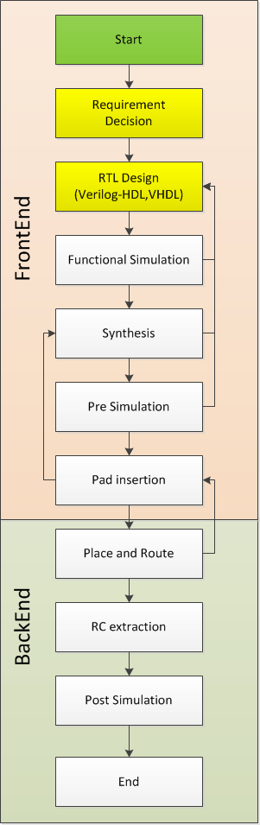
Set the Target Design
For example
Design : FIR Filter 37tap
Directive Stucture(16bit)
Tool : Synopsys Design compiler, VCS, Astro
Library : IDEC-ANAM 0.25um
Design Requirements (For example)
Speed : up to 100MHz
Area : minimum
Power : minimum
ps.
You can find All files for test “/home/your ID/example”
CSA & VLSI Lab.

Slide 3

Functional Simulation
Use Cygwin or Xmanager …etc (SSH1 or 2 available Tools)
Login to Worksation : 163.180.118.38
ID / PW : Your student number
Make a Directory for your design
    (ex :[ ID @Sun38 ~]$ mkdir FIR_FILTER)
    make Directorys “Func_sim”, ”Syn”,”Pre_sim” inside Design DIR
    then put in your design with testbench in “Func_sim“ DIR (verilog-HDL )
CSA & VLSI Lab.

Slide 4
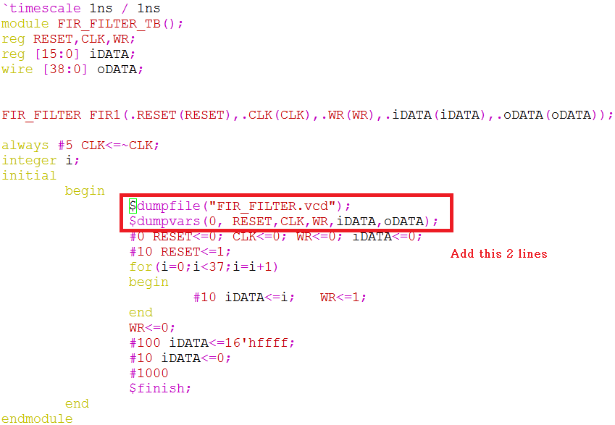

Edit Testbench code for Simulation
Add following lines in TestBench
$dumpfile(“waveform.vcd”);
$dumpvars(0, signals you want);
And define $finish;
And then make “design_files.f”
Add all your Design files and Testbench Code
CSA & VLSI Lab.

Slide 5
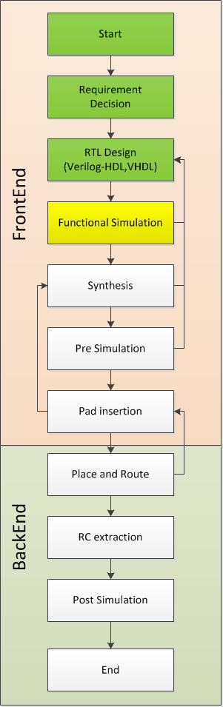
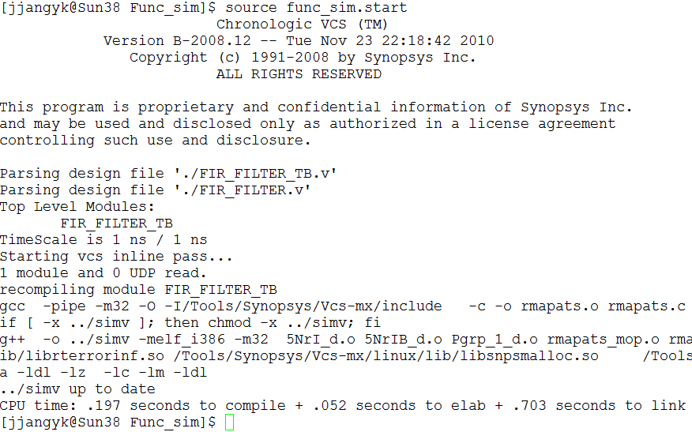
VCS
Now.. Simulate Testbench -> “source func_sim.start”
You have to Confirm “No error” -> “./simv”
CSA & VLSI Lab.

Slide 6
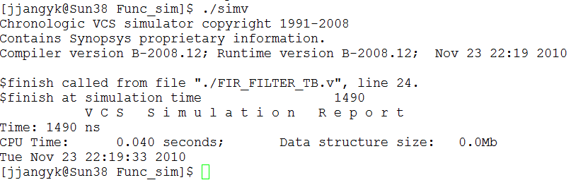
simv
Also You have to Confirm “No error”
And Then “dve &”
CSA & VLSI Lab.

Slide 7
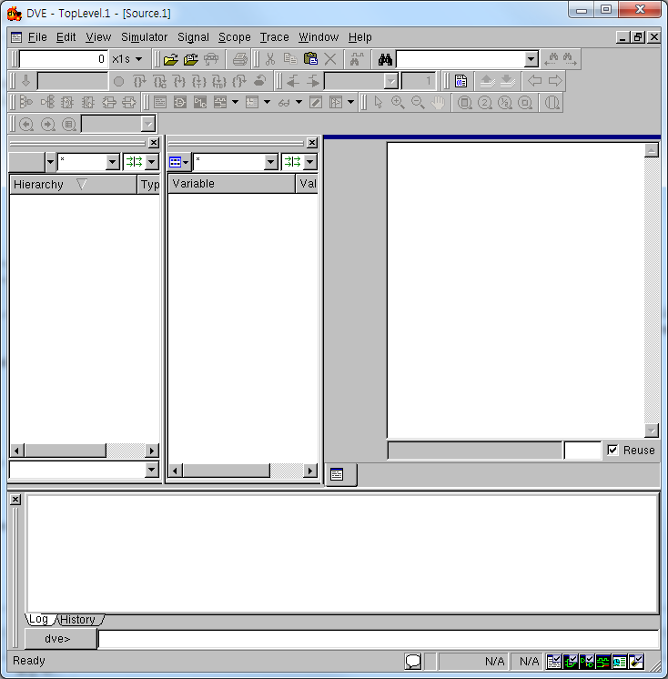
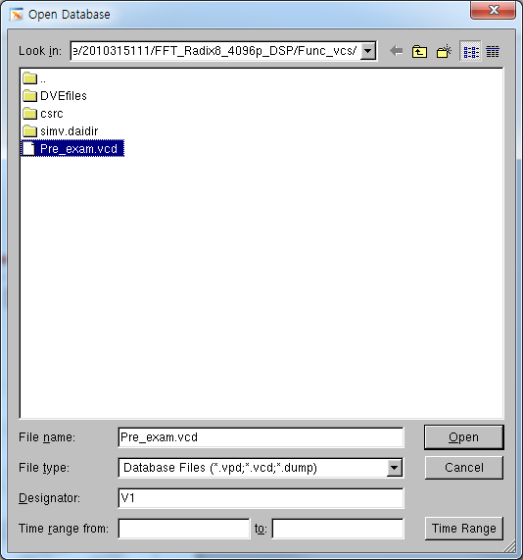
DVE
File->Open Database
Choose “Pre_exam.vcd”
CSA & VLSI Lab.

Slide 8
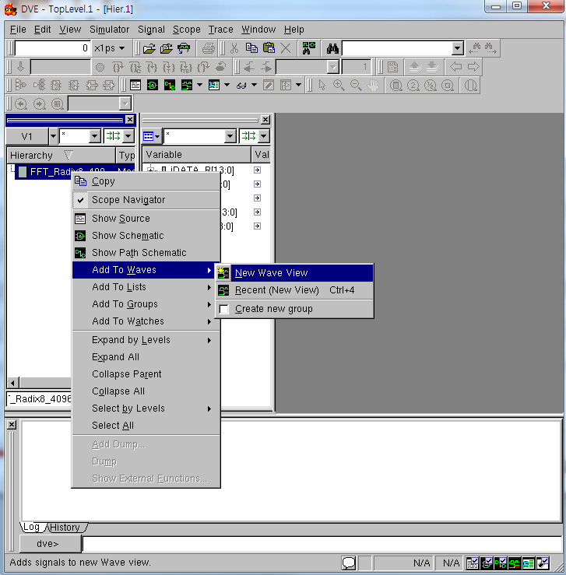
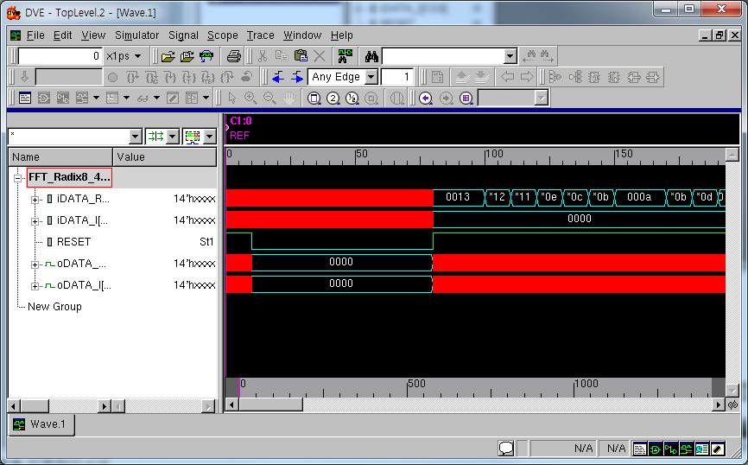
DVE
Right Click
Choose Add to Waves
-> New Wave View
Useful Blind Key
“ f, +, - “
CSA & VLSI Lab.

Slide 9

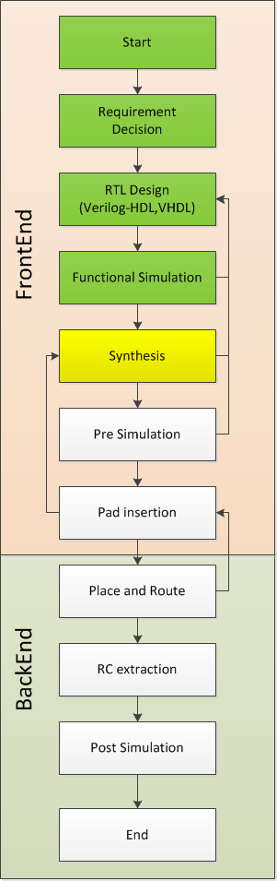
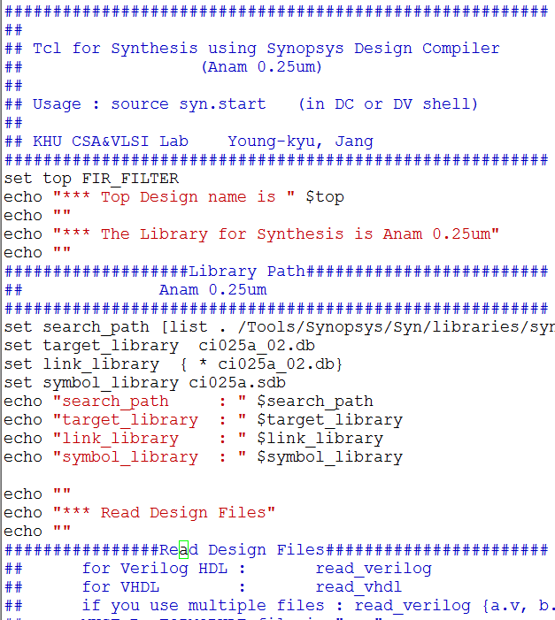
Synthesis
Select Design & Edit Constraints
We need “syn.start” file for synthesis and make DIR (output,log) in your “Syn” DIR before synthesis process
Put in your design
Ex) FIR_FILTER.v
then vi syn_anam025.start
Detail information in
Synopsys Synthesis Commands.pdf
Important
clk != CLK
Use same char
CSA & VLSI Lab.

Slide 10
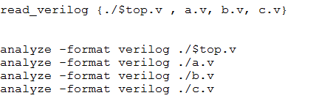
Select Design & Edit Constraints
If you use Hierarchy design, Follow this form
read_verilog {Top_module.v , a.v, b.v, c.v}
Setting another your constraints!
And quit( esc & :wq)
CSA & VLSI Lab.

Slide 11
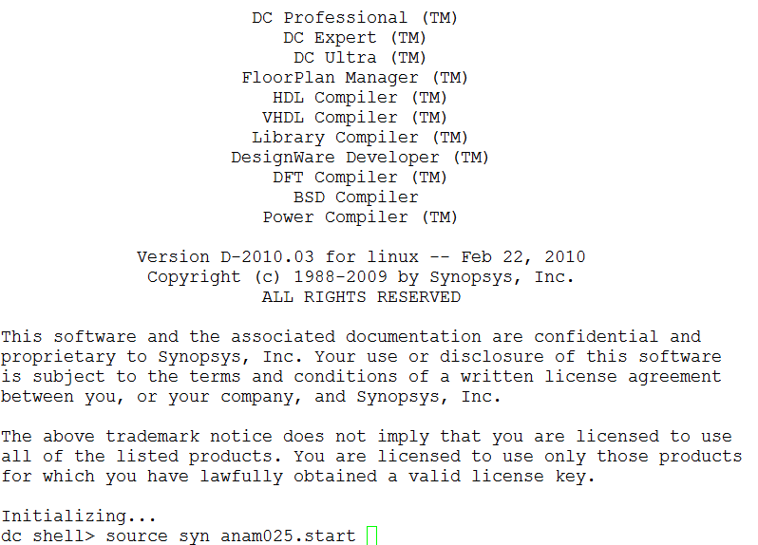
Synthesis
execute ‘dc’ //execute design_compiler
Source syn_anam025.start //execute synthesis
CSA & VLSI Lab.

Slide 12
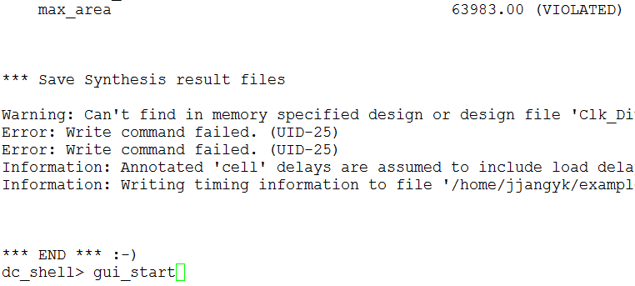
Synthesis result
If You can see any “violated” or any errors in progress
It means fail to satisfy the constraints
Modify your design to pass constraints
In this example , I set constraint of max_area = 0
because I want to make minimum area
But if You can use less than 64,000 then return RTL step, modify your design
We don’t USE over 100,000 Cells Design (we use small chip) in Place n Route(P&R) course!
CSA & VLSI Lab.

Slide 13
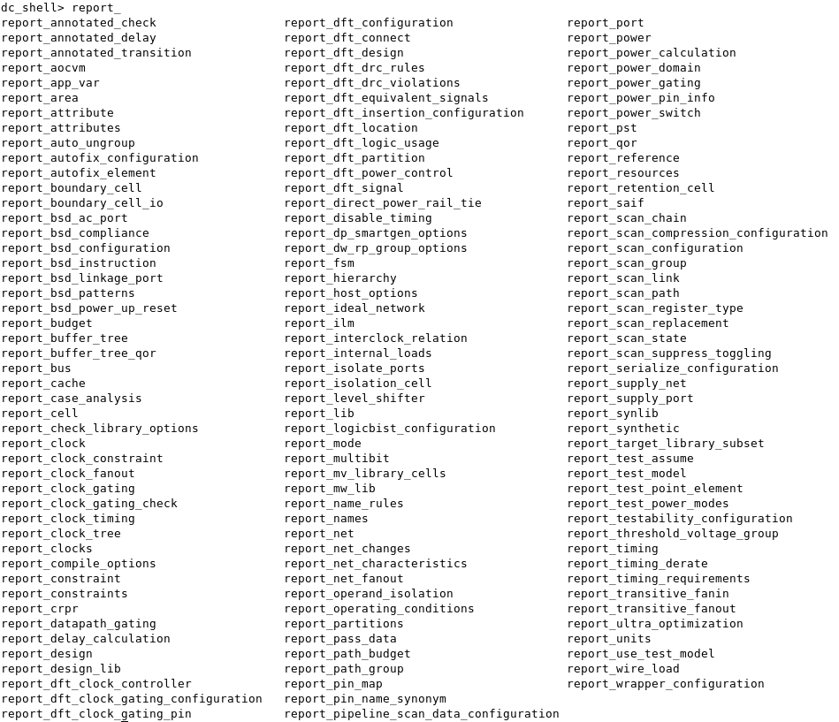
Synthesis report
After Synthesis, You have to check report
Type “report_” and push ‘tab’ key
if You aren’t satisfaction about the report, you should modify your design and do synthesis again.
CSA & VLSI Lab.

Slide 14
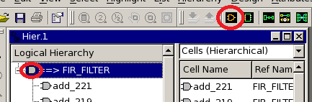
Check Design using Design_Vision
Check ‘G’ Mark that means fail or not finished job)
Choose Topname(FIR_FILTER) and click “Create Design Schematic” icon
CSA & VLSI Lab.

Slide 15
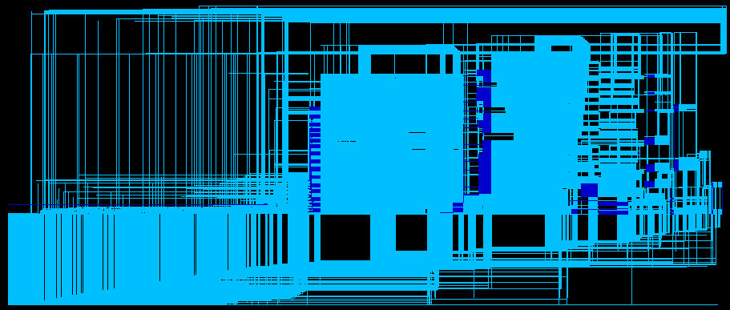
Synthesis finished
You will see like below picture
Check Input port & Output port
CSA & VLSI Lab.

Slide 16
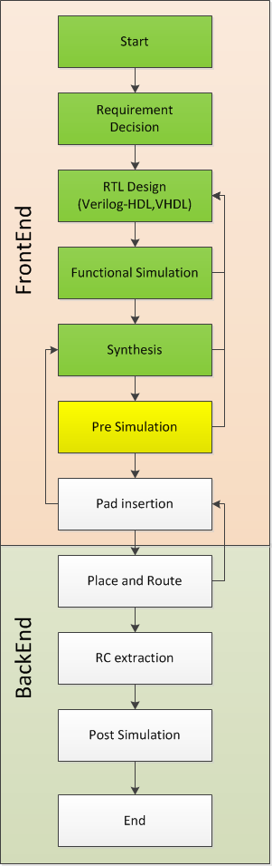
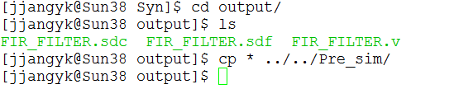
Pre simulation
Copy all files of Synthesis result(./Syn/output/*)
to “Pre_sim” DIR
Method of Pre simulation is almost Same that Functional Simulation.
When you Edit Testbench Code for VCS,
Add just 1 line
“$sdf_annotate(“./design_name.sdf”,design_name);
Below the $dumpvars line
CSA & VLSI Lab.

Slide 17
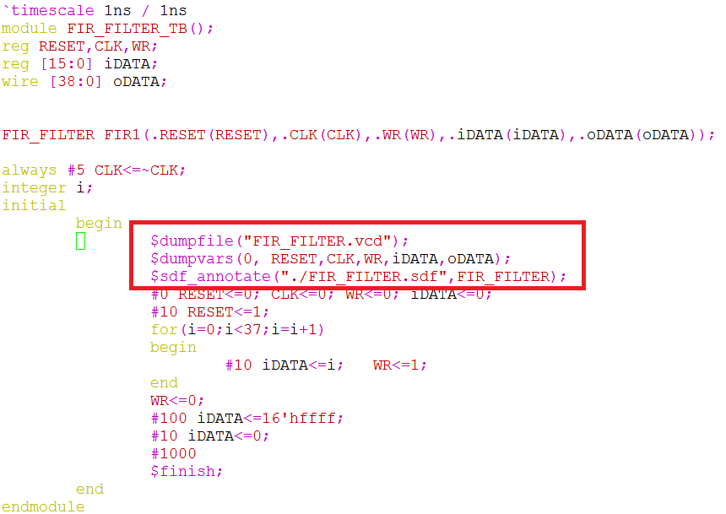
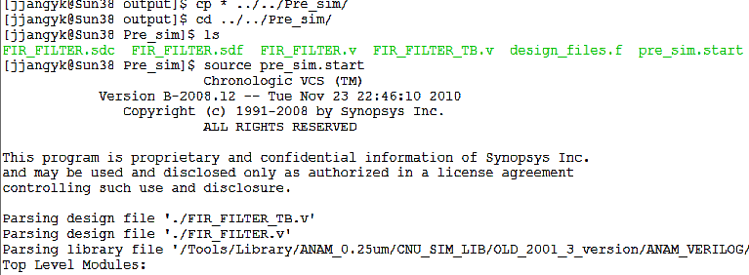
And then
source pre_sim.start
CSA & VLSI Lab.

Slide 18
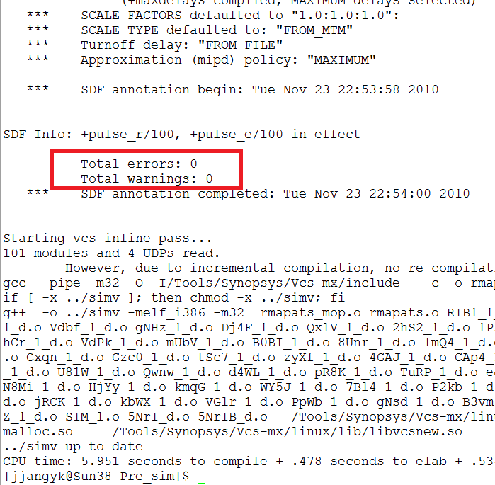
You have to Check “No Error”
After Process is Same ~
./simv
dve &
And Check Waveform
CSA & VLSI Lab.

Slide 19
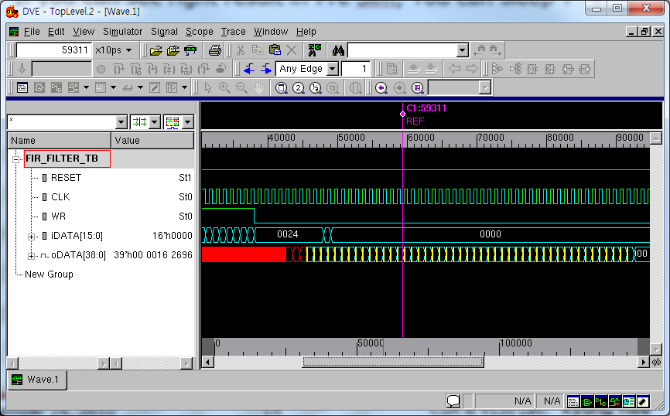
Pre Simulation Result
This is right result of Pre Sim(We can check some delay and glitch)
But result must be same with Functional simulation.
You’ve just finished core synthesis!
CSA & VLSI Lab.

Slide 20
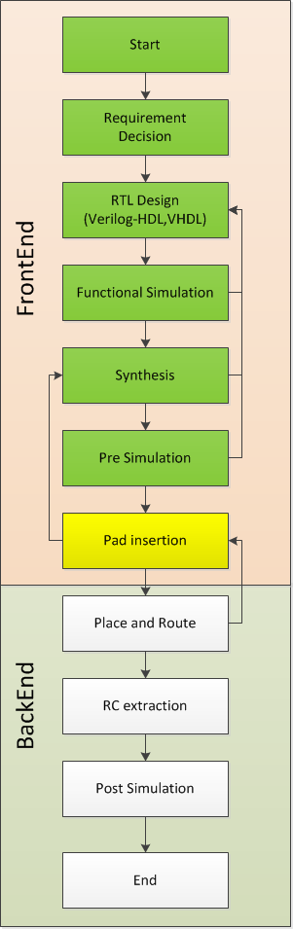



Pad Insertion
Synthesis result in ./Design_DIR/Syn/output
FIR_FILTER.v(netlist)
FIR_FILTER.sdc(Constraints)
FIR_FILTER.sdf(Cell Delay Information)
Make new Directory “Syn_Pad” in Design root DIR
Copy netlist file to Syn_Pad DIR
CSA & VLSI Lab.

Slide 21
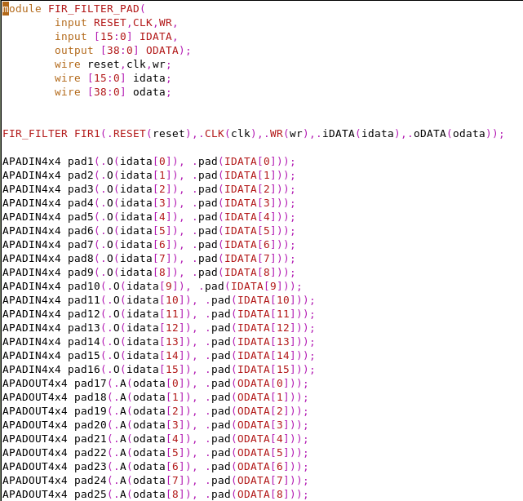
Pad Insertion
Make a new .v file -> FIR_FILTER_PAD.v
In this file,
We will add Pads
Internal External
  Core <-> Pad <-> Pin
Instance Core.
Link pads using wire.
I will give a Excel File
to generate pad code
yourself
PADnetlist Maker.xls
CSA & VLSI Lab.

Slide 22


Pad Insertion
vi FIR_FILTER_PAD.v
Type G
  Move End of File
Push ESC
Type :r FIR_FILTER.v
  Insert FIR_FILTER.v to cursor point
Push ESC
Type wq
CSA & VLSI Lab.

Slide 23
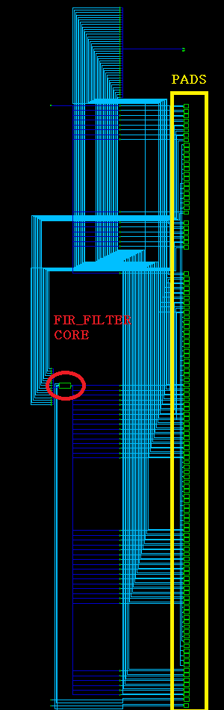


Pad Synthesis
“dc” -> “source syn_anam025_pad.start”
Top module is FIR_FILTER_PAD
Check Core & Pads in DV window
  Result must have Core & All Pads.
  if you can’t find one of them, you should go back process
  It means “Pad Insertion fail”
CSA & VLSI Lab.

Slide 24
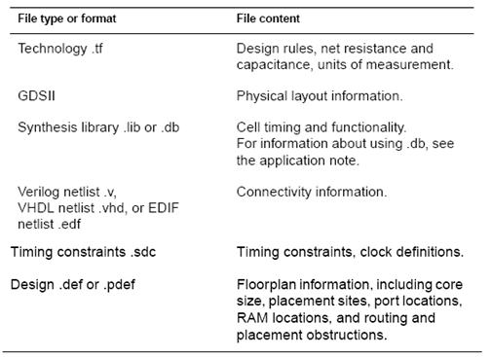
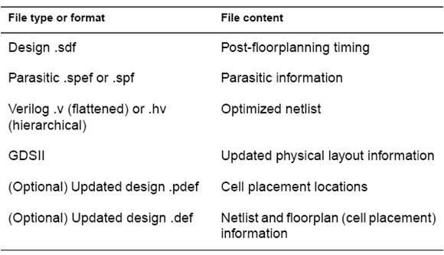
Astro Input and Output
Astro Output Files
Astro Input Files
CSA & VLSI Lab.

Slide 25
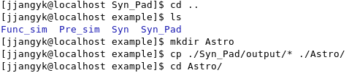

Preparing P&R
Now We get Finally 3 file : ./example/Syn_pad/output/
FIR_FILTER_PAD.v (Core netlist with pad)
FIR_FILTER_PAD.sdc (Constraints)
FIR_FILTER_PAD.sdf (Cell Delay information)
Make a new DIR “Astro” in Design root DIR
Copy All results to Astro DIR
CSA & VLSI Lab.

Slide 26
Common Informations for P&R Process
We use Anam 0.25um Standard Cell Library
Library DIR :
/Tools/Library/ANAM_0.25um/Apollo_PR_LIB
TECH files(.tdf, .tf, .clf)
  ./Library DIR/TECH/
Cells
  ./Library DIR/ANAM/
  ./Library DIR/ANAM_IO/
CSA & VLSI Lab.

Slide 27
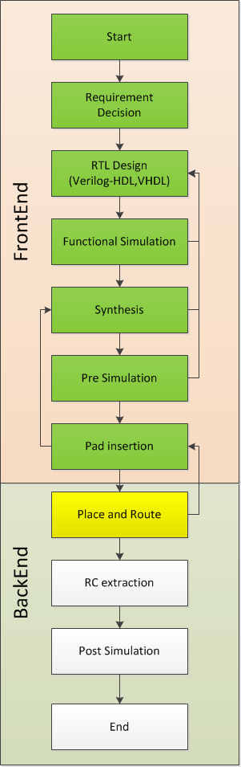
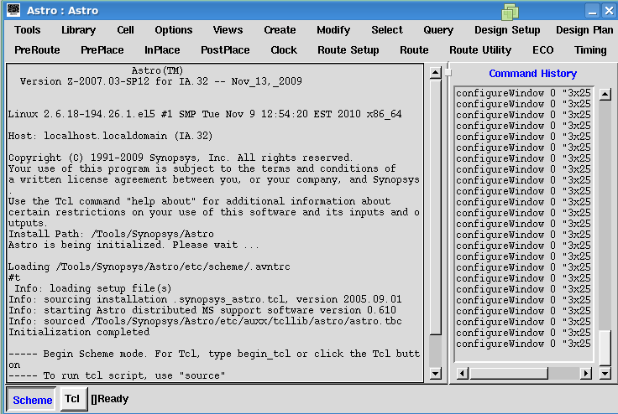
Run Astro
Move to ./Design DIR/Astro DIR
Type “Astro”
CSA & VLSI Lab.

Slide 28
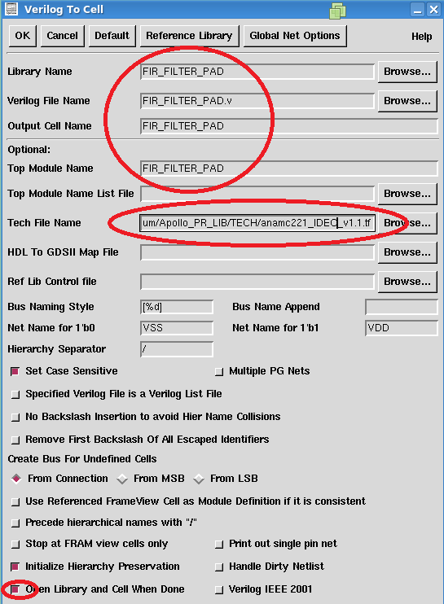
Load Synthesis Result
Tools > Data Prep
Netlist In > Verilog To CEL
Fill the Blank like Picture
TECH file :
/Tools/Library/ANAM_0.25um/Apollo_PR_LIB
/TECH/anamc221_IDEC_v1.1.tf
CSA & VLSI Lab.

Slide 29
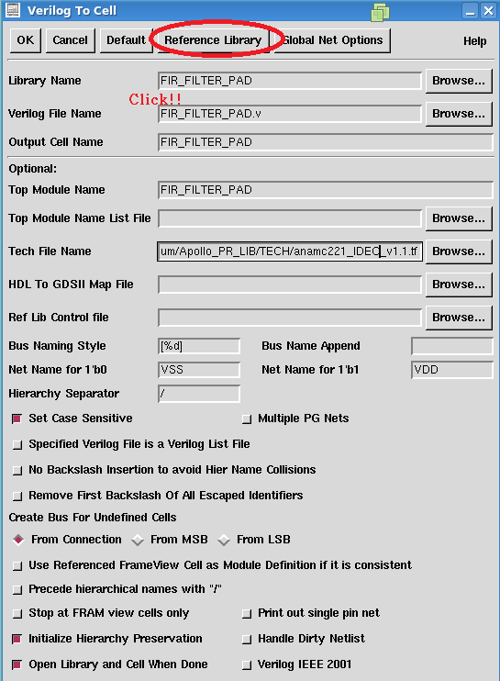
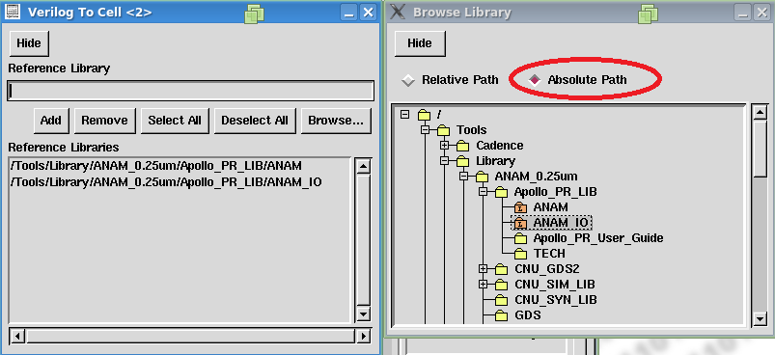
Library Setting
Add Two Library
Use Absolute Path
And then Hide
CSA & VLSI Lab.

Slide 30
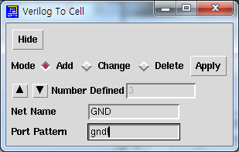
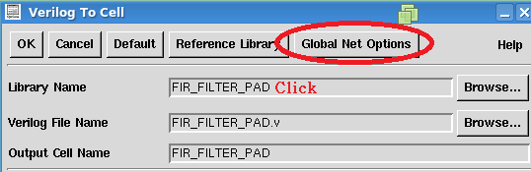
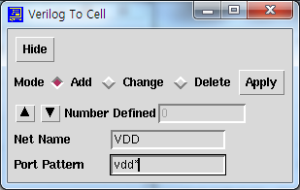
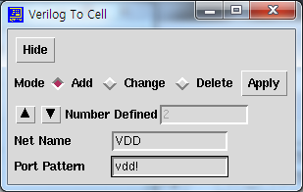
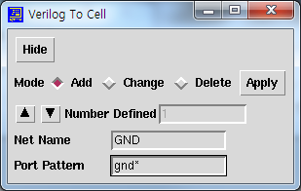
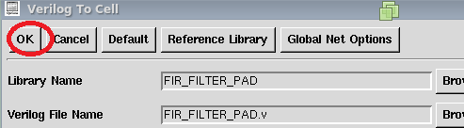
Global Net Setting
Remember …. We use VDD, GND
And then Click OK~
CSA & VLSI Lab.

Slide 31
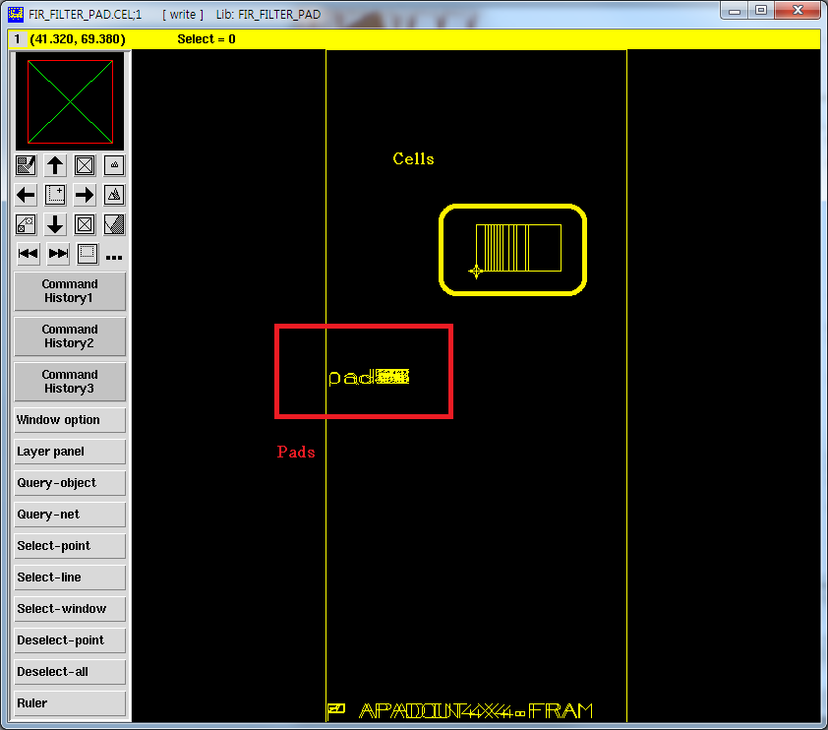
Loaded Design
Check the Cells & Pads
CSA & VLSI Lab.

Slide 32
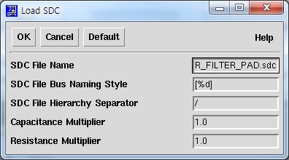
SDC(constraints) Load
.sdc file modification Before Loaded
set_ideal_network [get_ports CLK]
-> set_propagated_clock [get_clocks CLK]
Tools > Astro
Timing > Load SDC File
Name is “FIR_FILTER_PAD.sdc”
<=We get this file after synthesis
CSA & VLSI Lab.

Slide 33
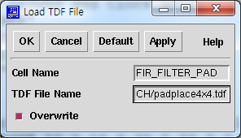
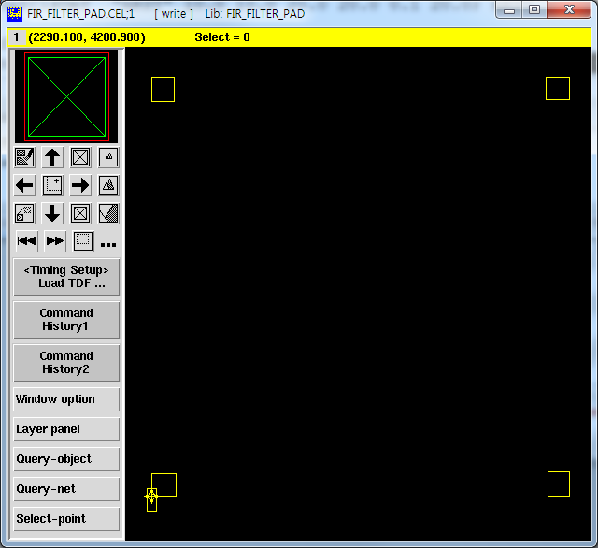
Load TDF file
We will use 4mm x 4mm die size 120pin package
TDF File has Pads location information of chip
Timing Setup > Load TDF File
TDF file location : /Tools/Library/ANAM_0.25um/ASTRO_LIB/TECH/padplace4x4.tdf
Push ‘F’ key in Cell view window
You will see this picture
CSA & VLSI Lab.

Slide 34
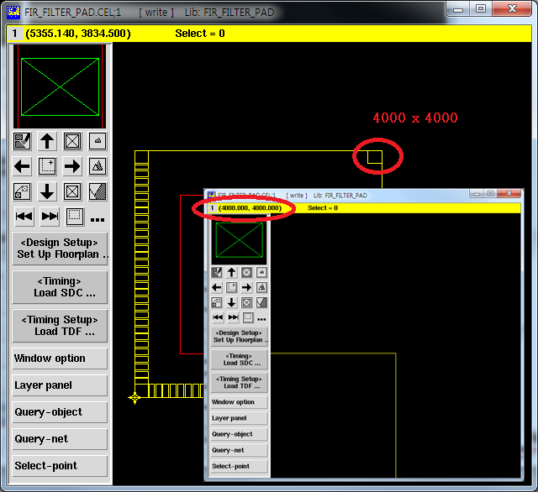
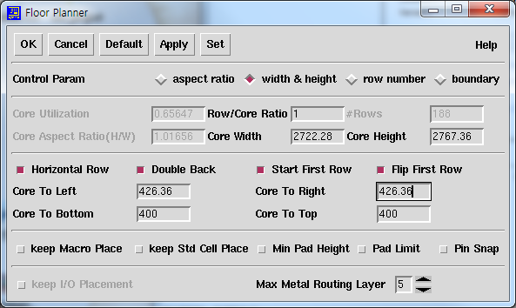
Floor Planning
I Recommend that the value of Core Utilization is nearly 0.65(35% for routing or margin)
Adjust core width & Height & Margin -> top right coordinates must be (4000.00,4000.00)
Useful blind key z(zoom), f(focus) , Drag(position to zoom)
Then click OK button.
CSA & VLSI Lab.

Slide 35
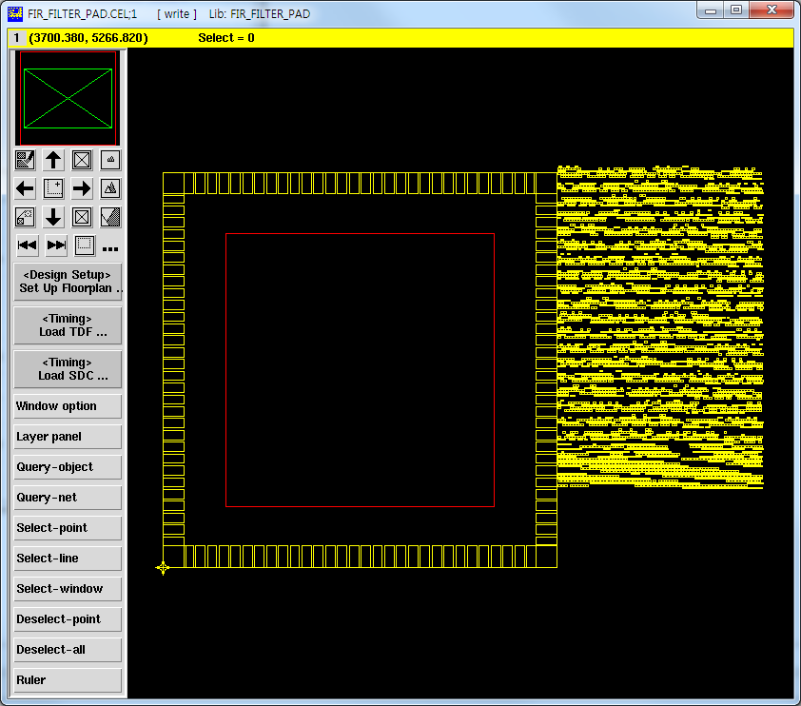
Floor Planning
Red Box = Core Area
CSA & VLSI Lab.

Slide 36
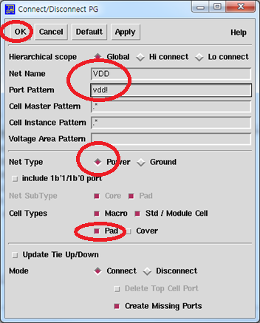
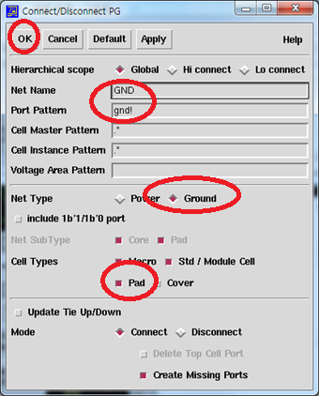


Connect Ports to Power/Ground
PreRoute > Connect Ports to P/G
CSA & VLSI Lab.

Slide 37
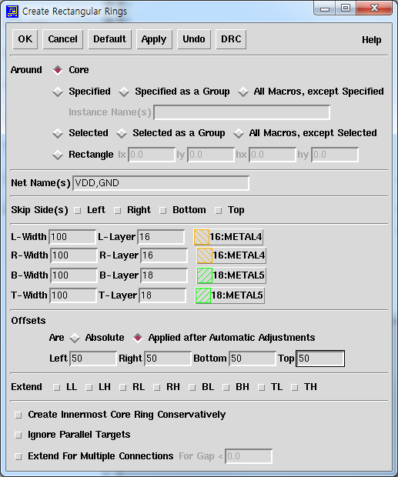


Create Rectangular Rings
PreRoute > Create Rectangular Rings
CSA & VLSI Lab.

Slide 38



Macros/Pads
PreRoute > Macros/Pads
CSA & VLSI Lab.

Slide 39


Design Placement
InPlace> Design Placement
CSA & VLSI Lab.

Slide 40



Standard Cells
PreRoute > Standard Cells
CSA & VLSI Lab.

Slide 41




Global Route / Detail Route
Route > Global Route Route > Global Route
CSA & VLSI Lab.

Slide 42


Route Finished
CSA & VLSI Lab.

